Slide 1
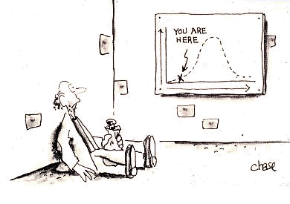
Z scores and t scores
Geog4300/6300
Jerry Shannon

Slide 2
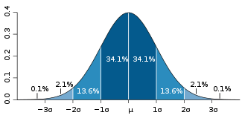
Normal distribution
A continuous graph that is symmetric around the mean.
Similar to a binomial distribution with an infinite number of outcomes
It is NOT used to calculate discrete outcomes.

Slide 3
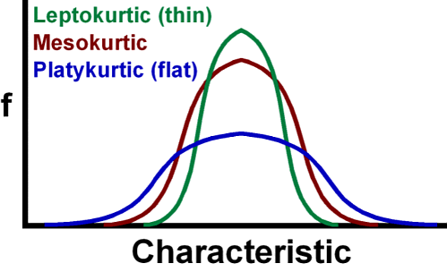
Z scores
There’s many different normal distributions as well!

Slide 4
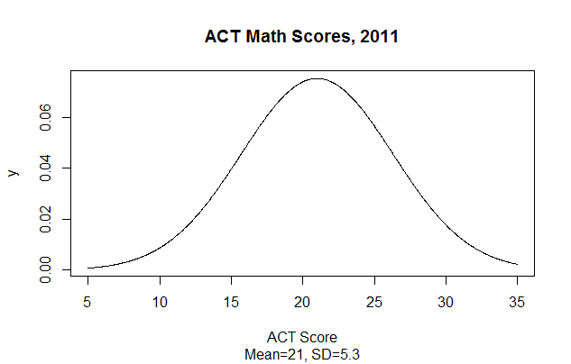
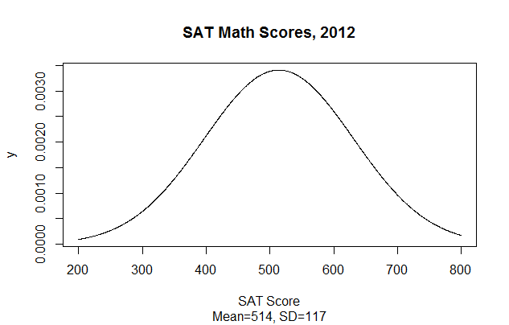
Z scores
Nigel got a 29 on his ACT and a 670 on his SAT. How do those compare?
Math SAT score distribution, 2012

Slide 5
Z scores
We can “measure” where this value is in the distribution by identifying the middle (mean) and using standard deviation to show distance from the mean.

Slide 6
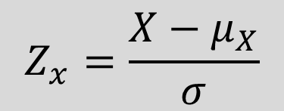
Z scores
How many standard deviations is this value from the mean?
ACT
Z(29) = (29 – 21) / 5.3
Z(29) = 1.51
SAT
Z(670) = (670 – 514) / 117
Z(29) = 1.33
Math SAT score distribution, 2012

Slide 7
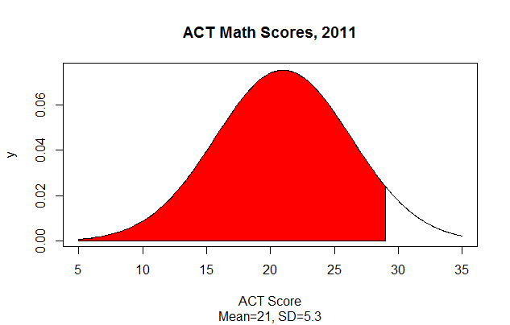
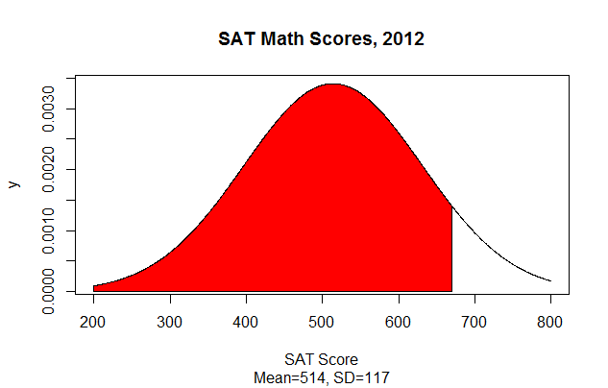
Z scores and percentages
What percentage of all students got less than this score? This is the area under the curve, assuming that
total area=1.
Either do some calculus (boring!)
or use a lookup table (p. 303 of McGrew and Monroe)

Slide 8
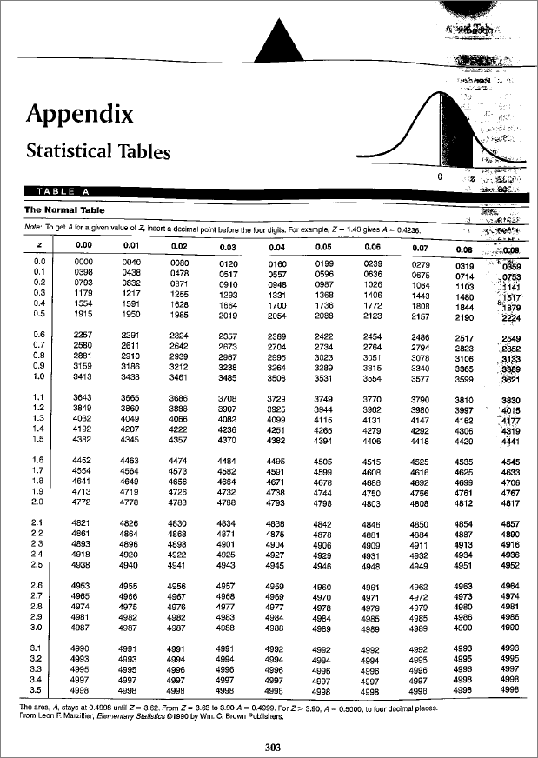
Z scores and percentages
ACT
Z score of 1.51 = .5 + .4345
93.45% of scores fall under
this value
SAT
Z score of 1.33 = .5 + .4082
90.82% of scores fall under
this value

Slide 9

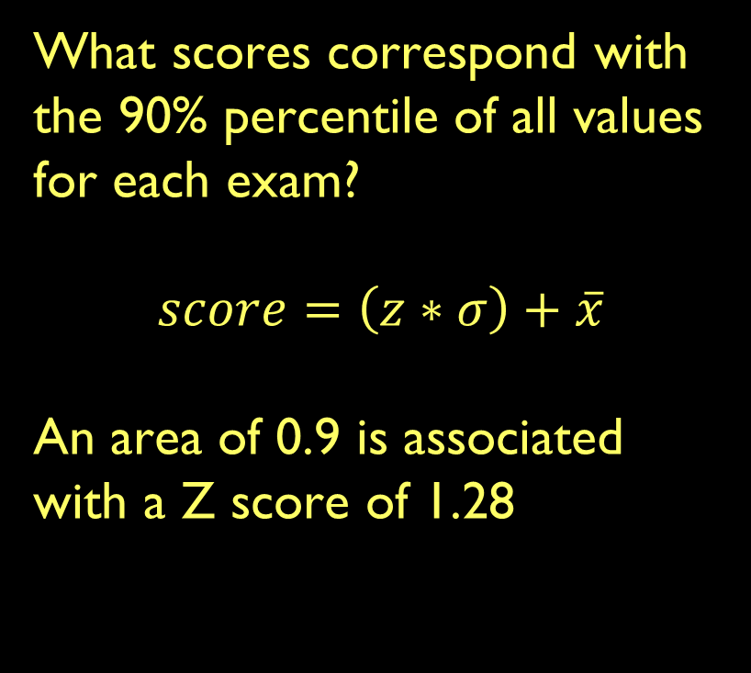
Percentile ranks
What scores correspond with the 90% percentile of all values for each exam?
$$score=\left(z∗σ\right)+\overline{x}$$
An area of 0.9 is associated with a Z score of 1.28
ACT
(1.28 * 5.3) + 21 = 27.8 (or 28)
SAT
(1.28 * 117) + 514 = 663.8 (or 664)

Slide 10
Practice
September temperatures in Athens are normally distributed. Their mean is 87 degrees, and their standard deviation is 7 degrees.
If the high temperature was 99 degrees yesterday, where does that rank among all September days?
What’s the probability of a day being between 75 and 85 degrees?

Slide 11
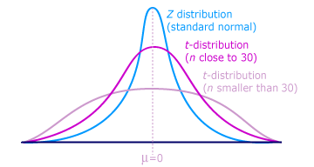
The T distribution
Problem: We don’t usually know either μ or σ
Solution: Create an estimate from our sample
To correct for uncertainty, we use the t distribution
Columbia
Notes:
T distribution changes depending on the size of your sample.
Generally best for samples with an n < 30

Slide 12

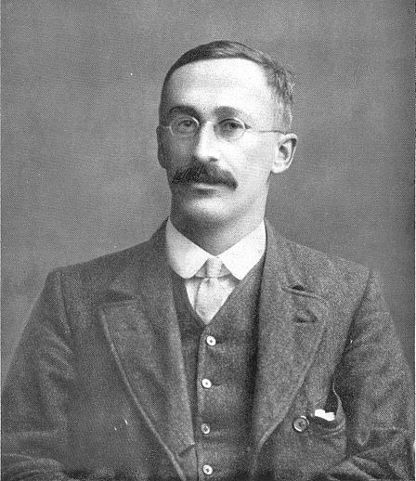
Why does the t distribution exist?
Beer
William Sealy Gosset
Notes:
T distribution was created by William Gosset. Hired in 1902 at Guinness brewery to help maximize quality of beer at a lower cost.
Problem of how to measure taste with only small sample sizes (limit on how much beer one man can drink)
He had to publish his results without his name because of the privacy restrictions Guinness put on their employees. Just the name “Student”.
Thus his statistical method is still known today as Student’s t-test.

Slide 13
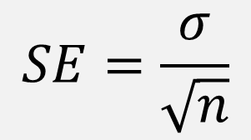
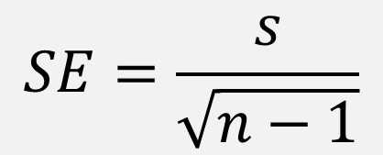
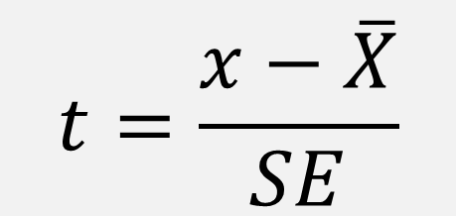
T scores—based on standard error
If standard deviation is known:
If standard deviation is unknown:
s = sample standard deviation
A t score-kind of like a z score

Slide 14
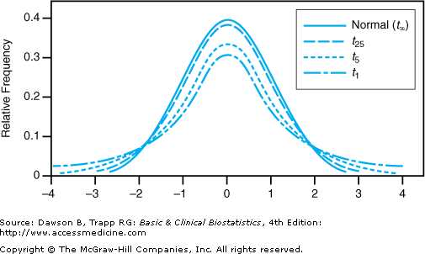
The flatness (kurtosis) of the t-distribution depends on the degrees of freedom (df)
Usually, df=n-1
T distribtion is usually only for data with df < 30

Slide 15
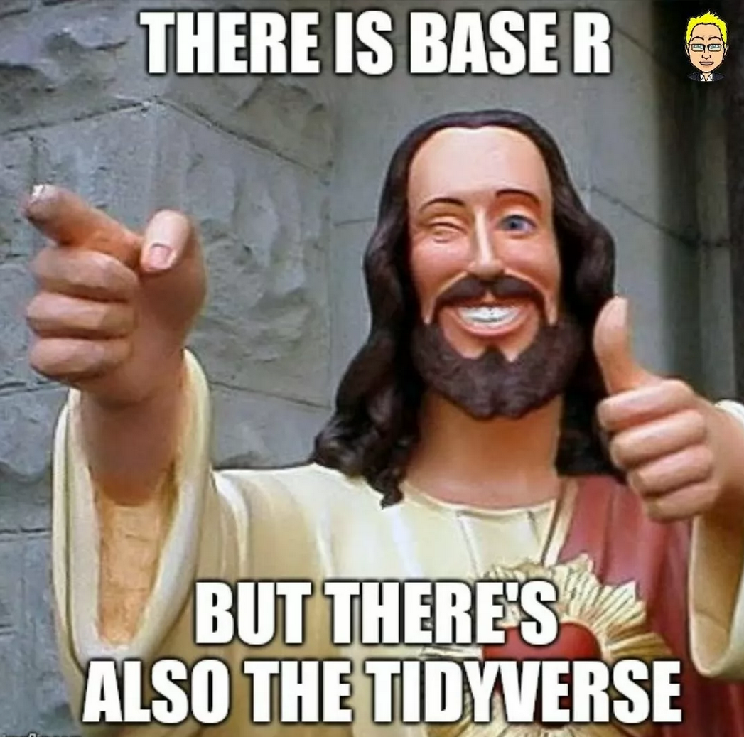
Let’s try this in R

